Slide 1
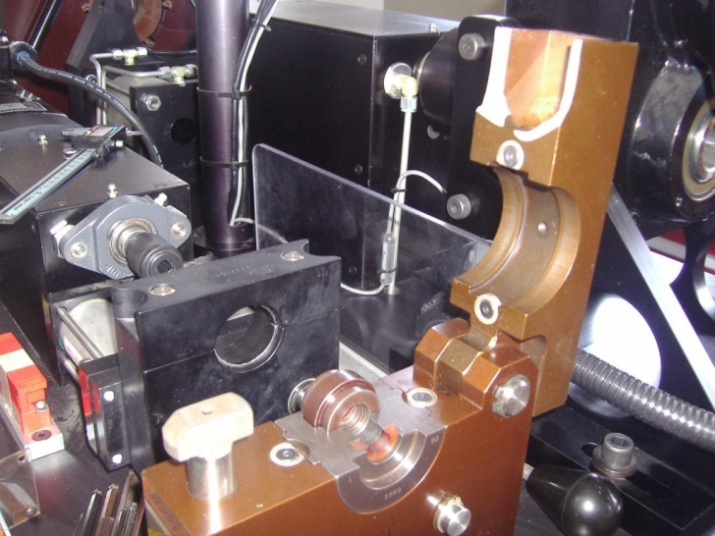
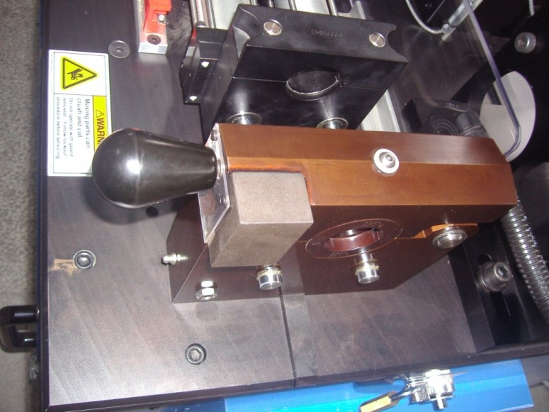
Upper Jaw Holder Broken
Large head upper jaw holder poped right before Chinese new year holiday
Repair solution provided during the holidays
Temporary solution: laser-welded jaw holder allowed machine back online 1wk after holiday

